Slide 1

Business helicopter view
Adobe Systems
Adobe Inc. operates as a diversified software company worldwide, with three main segments: Digital Media, Digital Experience, and Publishing and Advertising. Founded in 1982 and headquartered in San Jose, California, Adobe provides its products and services directly to enterprise customers and end users through various channels, including its website, app stores, and a network of distributors and resellers
Size
Business segments
Financial performance
leverage
sales
EBIT margin
employees | sales per FTE
30k FTE | 0.6m
sales | EBIT (margin)
19.4bn USD | 6.7bn USD (34.5%)
market cap | net debt (of equity)
256bn USD | -3bn USD (-1.2%)
1.8x | 2.0x | 3.5x | 1.5x | 3.2x | 0.8x | 1.2x
19.4bn USD
CAGR L3Y | 15.5% | CAGR L5Y | 20.1%
Notes: Financials taken as of latest financial year end
Sources: FMP, Chat GPT

Slide 2
Investment actionability
Adobe Systems
Share price development
_{USD}
Some comment on the stock generated by Chat GPT
Liquidity
share price (left)
volume (right)
market cap | free float
256bn USD | []
adtv 90d | on-balance-volume
[] | []
Return profile
return L3M | dividend yield
[] | []
vola 90d | VaR L3Y
[] | []
Sources: FMP, Chat GPT

Slide 3
Business development
Adobe Systems
Revenue growth
_{USD bn}
Key observations
+ 1.5 (25%) | + 1.7 (24%) | + 2.2 (24%) | + 1.7 (15%) | + 2.9 (23%) | + 1.8 (12%) | + 1.8 (10%)
Flattening growth aiming + 1.8bn USD annually
Investments mostly through R&D at ~20% of sales, outpacing revenue growth
Balance sheet capacity for further acquisitions
sales
YoY growth
YoY growth (%)
Investments in business
_{USD bn}
cash | 0.9 | cash | cash | cash | cash | cash
Net debt
Acquisitions
R&D
CAPEX
Sources: FMP, Chat GPT

Slide 4
Capital distribution
Adobe Systems
Investments in growth vs capital distributions
_{USD bn}
Key observations
+ 0.8 (0.4x) | + 6.1 (2.1x) | - 0.4 (0.1x) | - 0.4 (0.1x) | + 1.6 (0.3x) | - 3.5 (0.6x) | + 0.6 (0.1x)
Healthy mix of investments in the future and capital distributions to shareholders
Operating profit
Organic growth
Excessive growth
Capital distributions
Sources: FMP, Chat GPT

Slide 5
Profitability
Adobe Systems
Profitability margins
_{(%)}
Key observations
Gross profit
EBITDA
[]
EBIT
Net income
Sources: FMP, Chat GPT

Slide 6
Cost discipline
Adobe Systems
Operating cost structure and development
_{USD bn}
as of sales
Sales’23: 19.4bn USD
Cogs
_{USD bn}
R&D
_{USD bn}
EBIT’23
6.7bn USD
margin: 34%
SG&A
_{USD bn}
Interest
_{USD bn}
Sources: FMP, Chat GPT

Slide 7
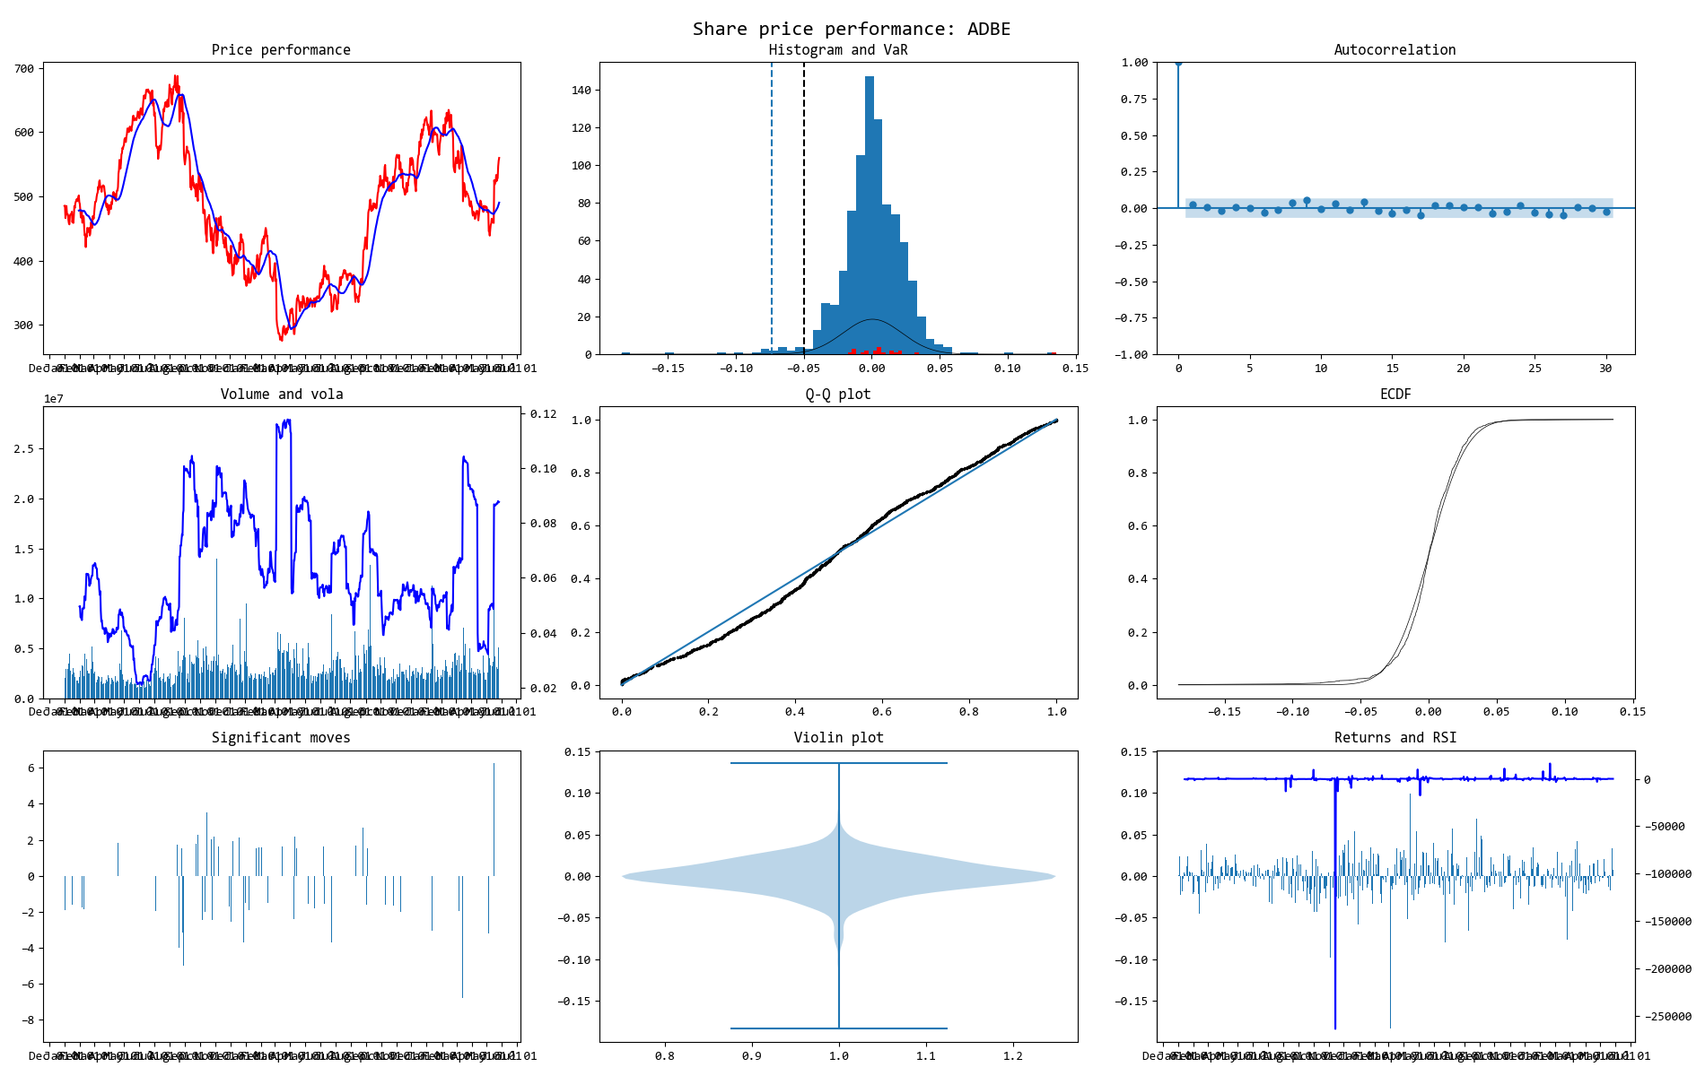
Price snapshot
Would be filled with stats
Adobe Systems

Slide 8
Business helicopter view
Adobe Systems
Adobe Inc. operates as a diversified software company worldwide, with three main segments: Digital Media, Digital Experience, and Publishing and Advertising. Founded in 1982 and headquartered in San Jose, California, Adobe provides its products and services directly to enterprise customers and end users through various channels, including its website, app stores, and a network of distributors and resellers
Size
Financial performance
Business segments
leverage
sales
EBIT margin
employees | sales per FTE
30k FTE | 0.6m
sales | EBIT (margin)
19.4bn USD | 6.7bn USD (34.5%)
market cap | net debt (of equity)
256bn USD | -3bn USD (-1.2%)
1.8x | 2.0x | 3.5x | 1.5x | 3.2x | 0.8x | 1.2x
19.4bn USD
CAGR L3Y | 15.5% | CAGR L5Y | 20.1%
Notes: Financials taken as of latest financial year end
Sources: FMP, Chat GPT

Slide 9
Architechture
FMP download
Static data
Price data
Financial statements
Input: json. Output: dataframe
Equity class
Collection of all data
Calculated data
Methods:
Prepare charts as png
Prepare tables as html
Prepare text as html
Ultimate method:
Prepare a story based on methods above as pdf of html
Supporting modules
Telegram bot
GUI for interacting with the project via pre-defined commands
[Ticker}
Prepare charts
Recalculate data for presentation purposes
Create and save a chart
LLM
Business description
Recent events
Peers
Market and trends
Input: string. Output: string/html
Prepare tables and text
Recalculate data for presentation purposes
Create and save as html

